Slide 1

Plant Disease Classification Using TensorFlow Transfer Learning A Project PRESENTATION Submitted by SAMYAK JHAVERI, B039 SHREY KAMDAR, B044

Slide 2
INTRODUCTION
Early and accurate detection and diagnosis of plant disease are key factors in plant production and the reduction of both qualitative and quantitative losses in crop yield. Non-destructive, sensor-based methods support and expand upon and/or molecular approaches to plant disease assessment. The most relevant application of sensor-based analyses are precision agriculture and plant phenotyping.
Computer vision and machine-learning solutions offer great opportunities for the automatic recognition of sick plants by visual inspection of damaged leaves.

Slide 3
IMPLEMENTATION
Gathering the Data
The ‘PlantVillage Dataset’ is a labelled, public dataset of 54,305 images of diseased and healthy plants collected under control conditions. This dataset was split into Training and Testing datasets.
Label Mapping
A supervised-learning model cannot make classifications of images without the help of labels assigned to those images. Hence it is necessary to load a mapping from category label to category name. This will give a dictionary mapping the integer encoded to the actual names of the plants and diseases.

Slide 4
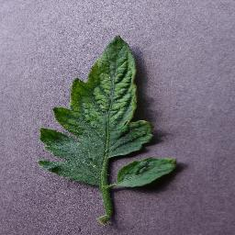
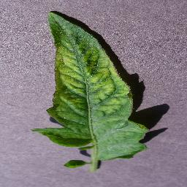
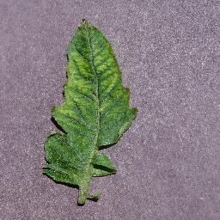
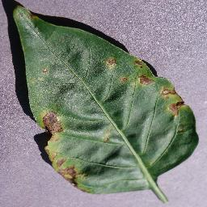
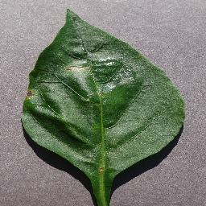
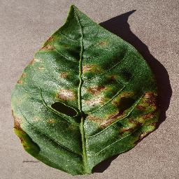
Tomato Leaves with Mosaic Virus
Bell pepper leaves with Bacterial Spots

Slide 5
Transfer Learning
Transfer learning generally refers to a process where a model trained on one problem is used in some way on a second related problem.
In deep learning, transfer learning is a technique whereby a neural network model is first trained on a problem similar to the problem that is being solved. One or more layers from the trained model are then used in a new model trained on the problem of interest.
Transfer learning has the benefit of decreasing the training time for a neural network model and can result in lower generalization error.

Slide 6
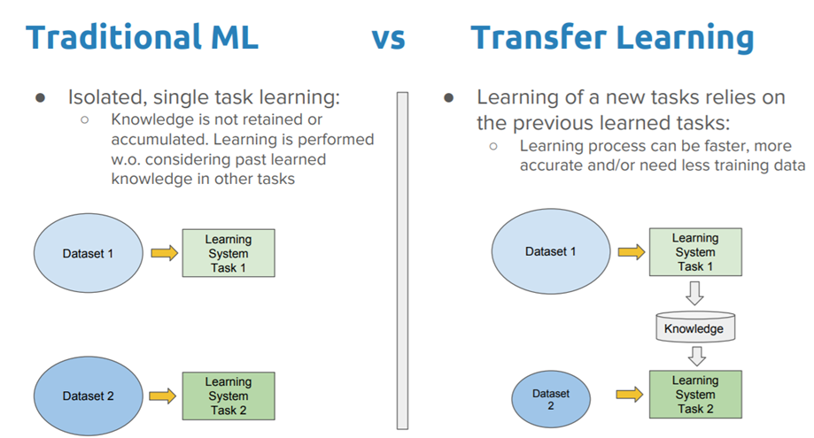

Slide 7
Data Preprocessing
The images were converted into ‘float32’ tensors and fed into the neural network, along with their labels. But before passing through the neural networks, the data must be normalized* to make it more amenable to processing by the network. In this case, the pixel values have been normalized to the range between 0 and 1(from the original range of 0 to 255).
Building the Model and Specifying Loss Function and Optimizer
A linear classifier is put on top of the feature_extractor with the TensorFlow Hub module.
The model is then compiled and the loss function and optimizers are specified. Here we have used ‘adam’ as the optimizer and ‘categorical crossentropy’ as the loss function, along with ‘accuracy’ as the metric of assessment of performance.

Slide 8
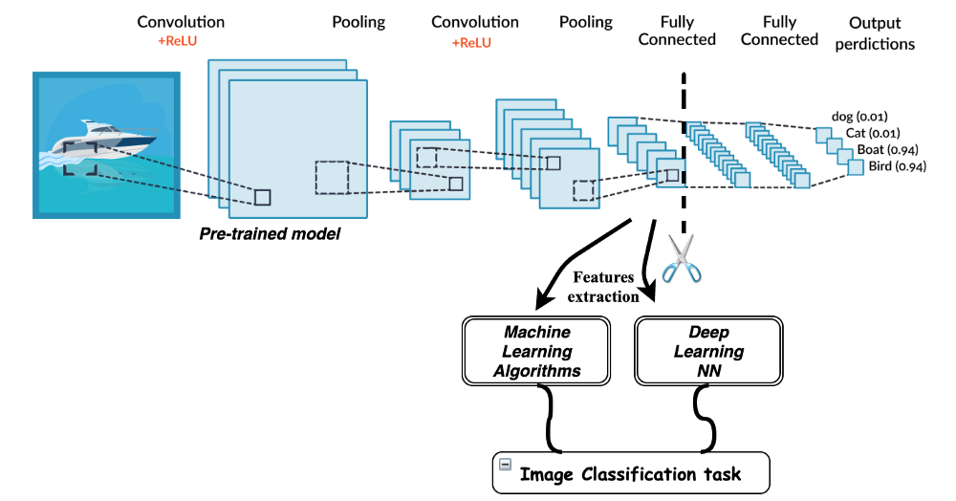

Slide 9
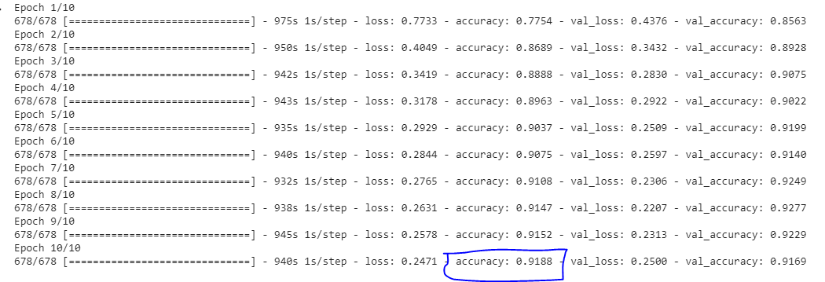
Training the Model
The model is trained on the testing part of the dataset and an accuracy of 92% after training for 10 epochs.

Slide 10
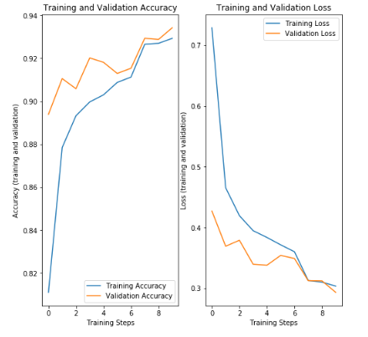
Checking Performance and Testing the Trained Model with Random images
The validation, accuracy and loss are plotted:
Here, it can be inferred that as the training steps progressed, both the training and texting accuracy climbed and the loss plummeted.

Slide 11
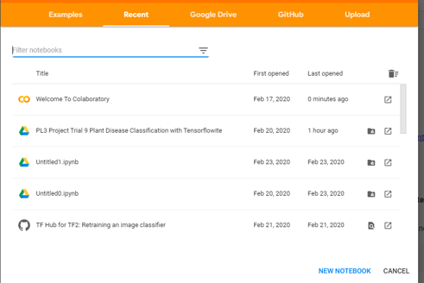
SOFTWARES AND APIs USED
Google Colab
In the initial stages of the project, it was observed that even loading the dataset into the Jupyter Notebook was too resource-intensive in terms of time and computation requirements.
Google’s Colab platform allowed us to make use of Google’s computation power to load, train, test and evaluate the data and neural network model architectures online with the use of hardware optimized for machine learning - GPUs and TPUs.

Slide 12
TensorFlow, TensorFlow Hub
The TensorFlow API offers multiple levels of abstraction to choose from in building and training models. TensorFlow also gave us flexibility and control over the execution of the models in which we used high-level Keras APIs.
Example:
import tensorflow as tf mnist = tf.keras.datasets.mnist (x_train, y_train),(x_test, y_test) = mnist.load_data() x_train, x_test = x_train / 255.0, x_test / 255.0 model = tf.keras.models.Sequential([ tf.keras.layers.Flatten(input_shape=(28, 28)), tf.keras.layers.Dense(128, activation='relu'), tf.keras.layers.Dropout(0.2), tf.keras.layers.Dense(10, activation='softmax') ]) model.compile(optimizer='adam', loss='sparse_categorical_crossentropy', metrics=['accuracy']) model.fit(x_train, y_train, epochs=5) model.evaluate(x_test, y_test)

Slide 13
TensorFlow Hub is a library for the publication, discovery, and consumption of reusable parts of machine learning models. A module is a self-contained piece of a TensorFlow graph, along with its weights and assets, that can be reused across different tasks in a process known as transfer learning. Transfer learning can:
-Train a model with a smaller dataset
-Improve generalization, and
-Speed up training.
!pip install "tensorflow_hub>=0.6.0" !pip install "tensorflow>=2.0.0" import tensorflow as tf import tensorflow_hub as hub module_url = "https://tfhub.dev/google/nnlm-en-dim128/2" embed = hub.KerasLayer(module_url) embeddings = embed(["A long sentence.", "single-word",
"http://example.com"]) print(embeddings.shape) #(3,128)

Slide 14
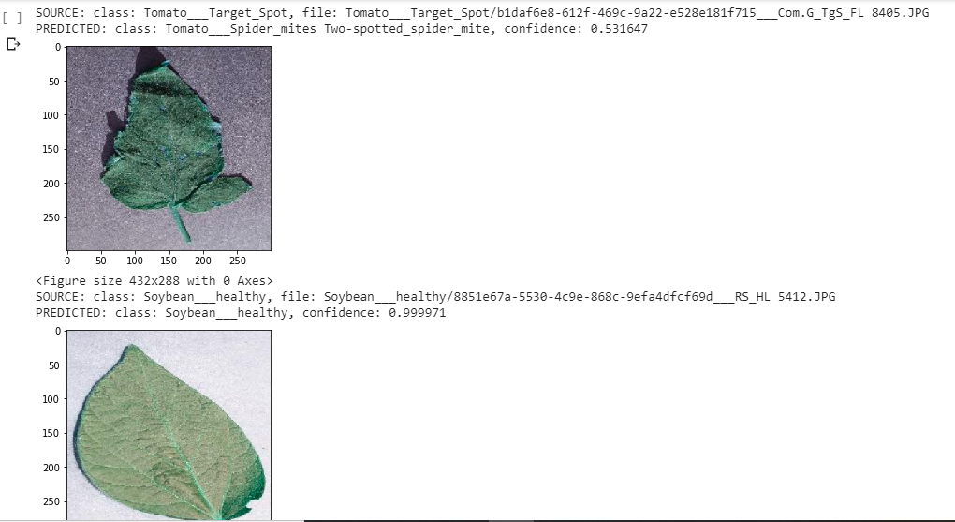
RESULTS OF SOME RANDOM TESTS:

Slide 15
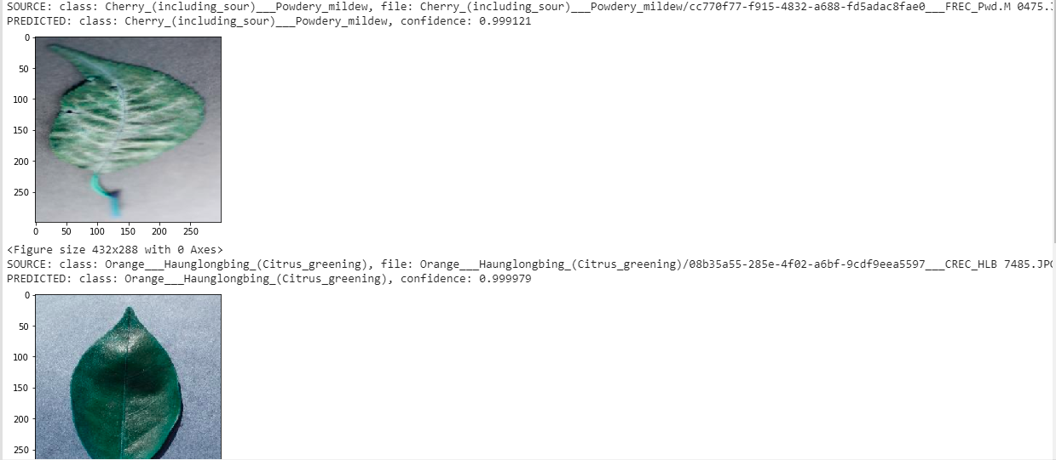
RESULTS OF SOME RANDOM TESTS:

Slide 16
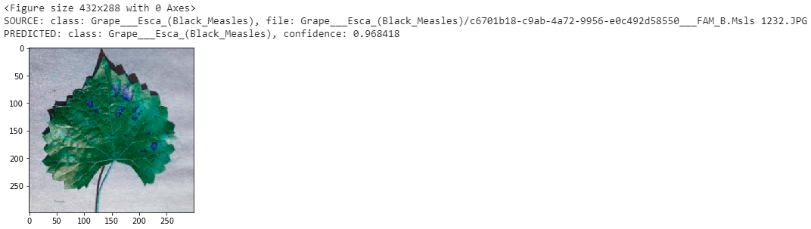
RESULTS OF SOME RANDOM TESTS:
With the help of transfer learning and Google Colab’s GPUs, this project successfully achieves a high accuracy rate at classifying the plant species and diseases without compromising speed at which the models can be trained or tested.

Slide 17
THANK YOU FOR YOUR TIME!

